Slide 1
SlugSync
Jayna-Product Owner
Ridhin- Scrum Master (Sprint 3)
Ricardo-Developer
Emiliano- Scrum Master(Sprint 1)
Kevin-Scrum Master(Sprint 2)

Slide 2
Brief introduction into problem/application domain
– What motivated your choice of project
Our Project is a application that helps students discover and track campus and local events in one place. The app collects and organizes events from websites students care about, with a primary focus on the UCSC events page. We also planned to support instagram and Discord servers as event sources, but thoise integrations were outside the scope of this initial project.
Intended Users
UCSC students looking to discover and organize campus and local events
Students who want one place to view all events from multiple sources.
Problem / Opportunity Addressed
Event information is scattered across university websites and other online platforms, making events easy to miss and not attend
Our app centralizes events into a single calendar by collecting information from websites students care about, making it much easier to discover and attend events.

Slide 3
Goals
Have a dashboard where you can see all your personal events as well as browse events in your area. Also being able to post events to this dashboard which can be seen by others
Have a calendar that is managed by your AI assistant but can also be manually edited
Get a daily digest of your schedule and potential events from your AI assistant catered to personal interest
Page where you can view your friends and see their calendars as well as a ‘Group Calendar’ which will be a shared calendar for you and your friends
We set these high level goals in the release plan and we achieved them all!
Notes:
Emiliano

Slide 4
Live Demo!

Slide 5
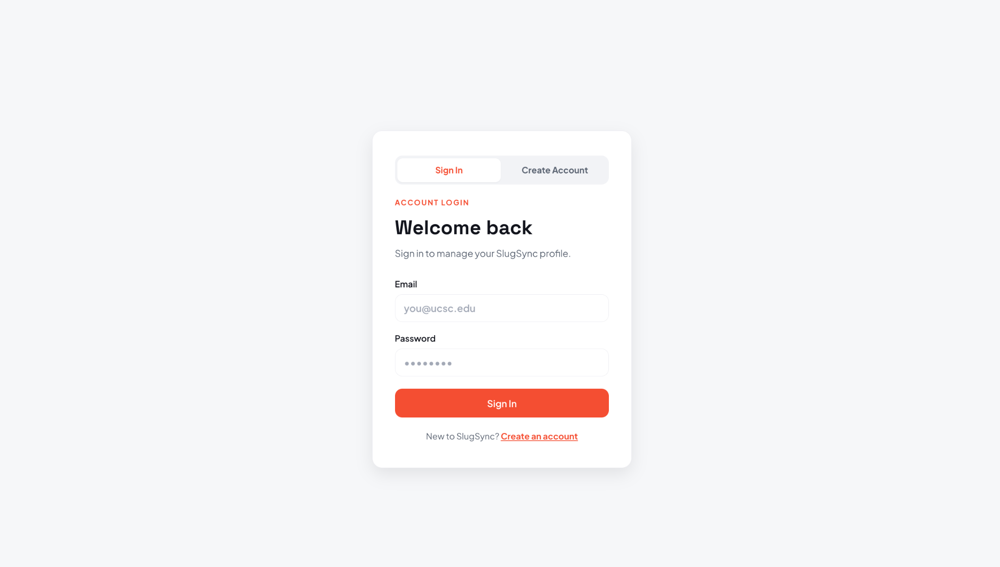

Slide 6
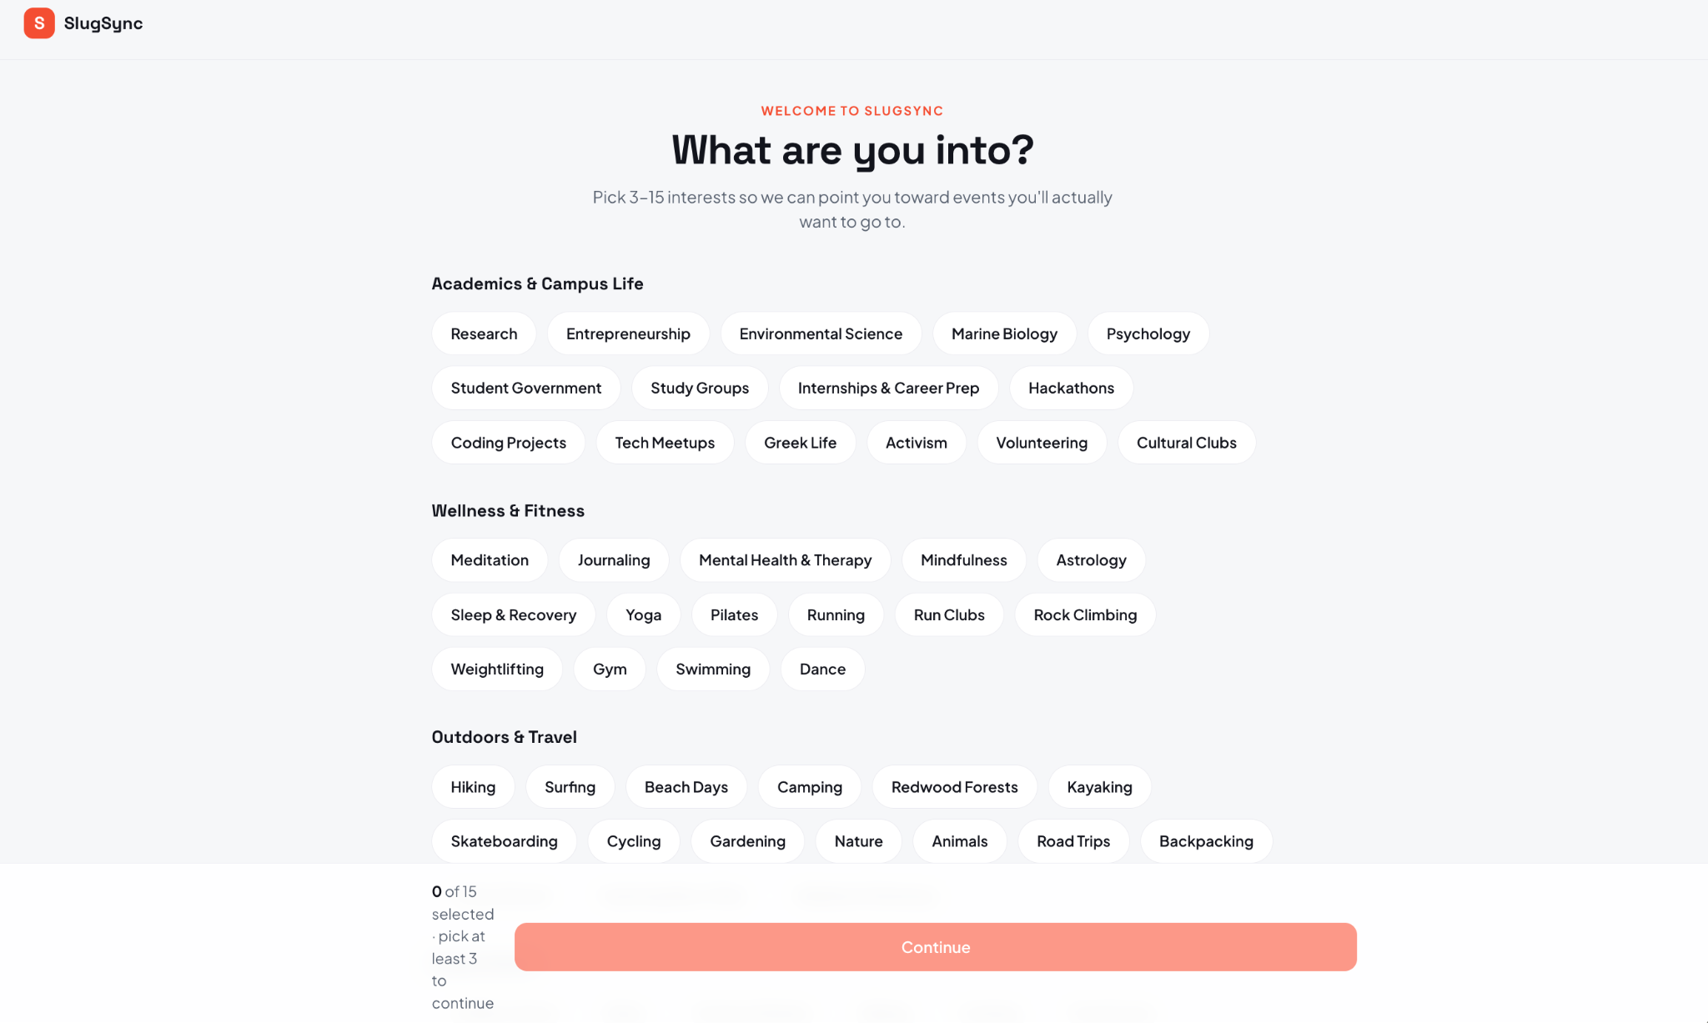

Slide 7
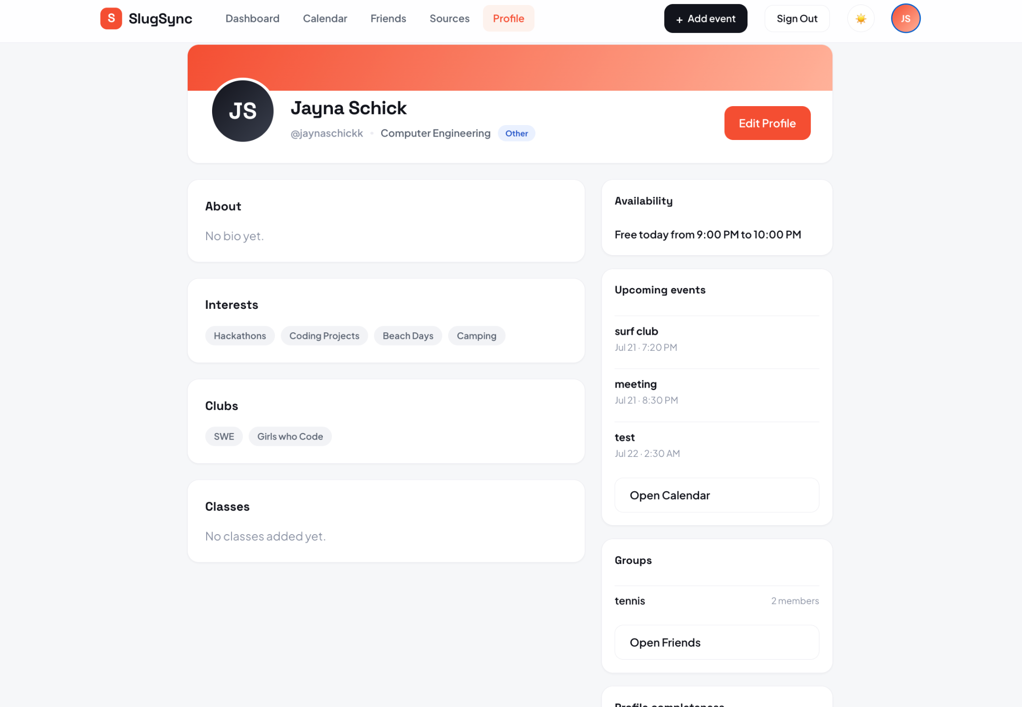

Slide 8
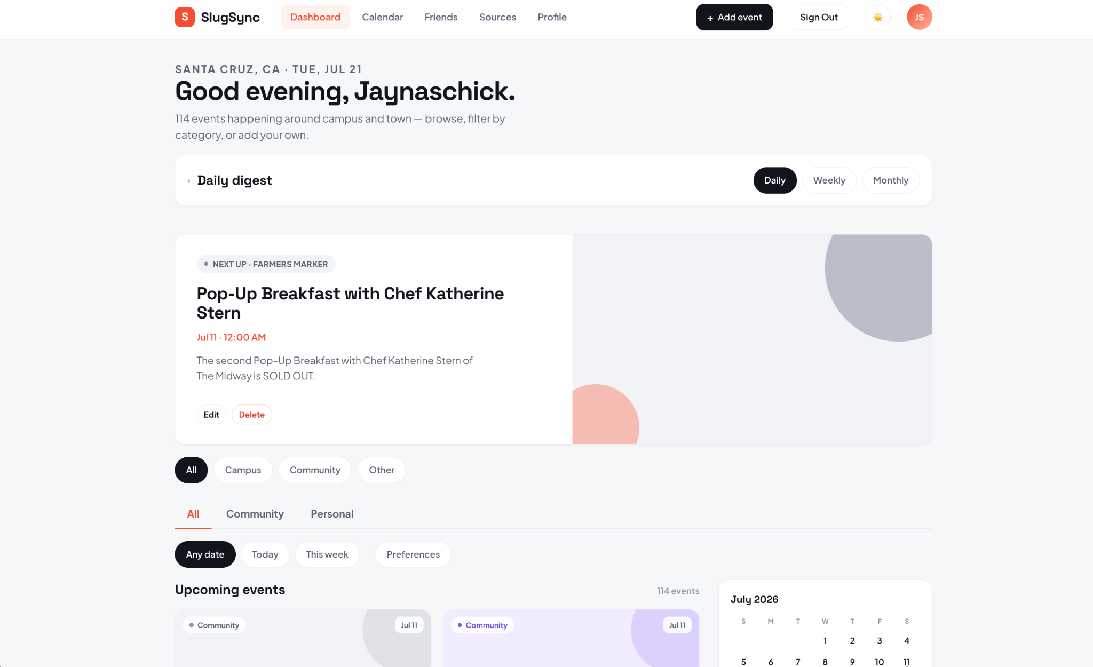

Slide 9
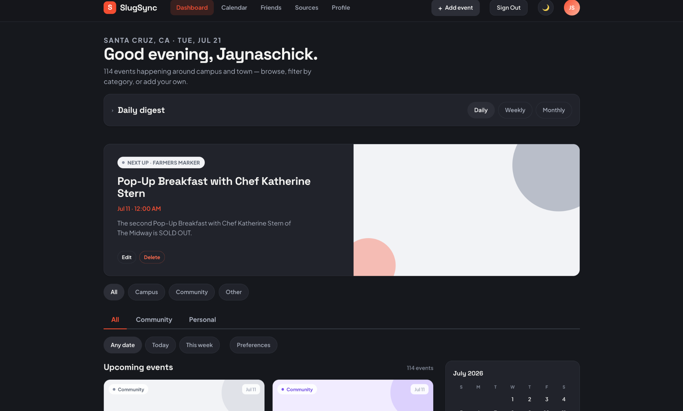

Slide 10
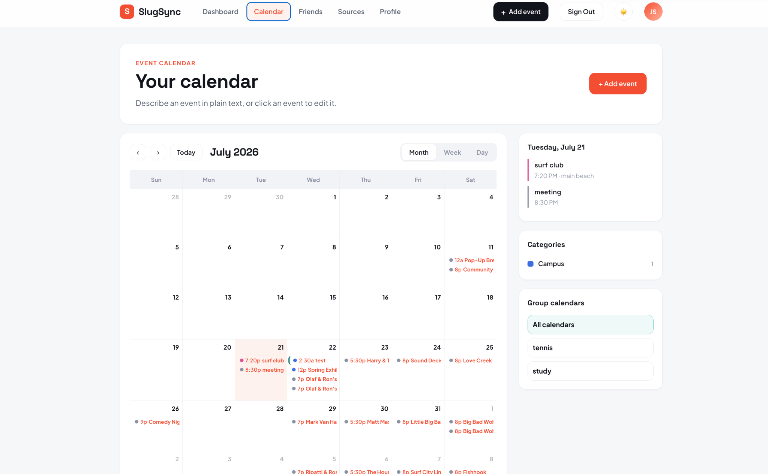

Slide 11
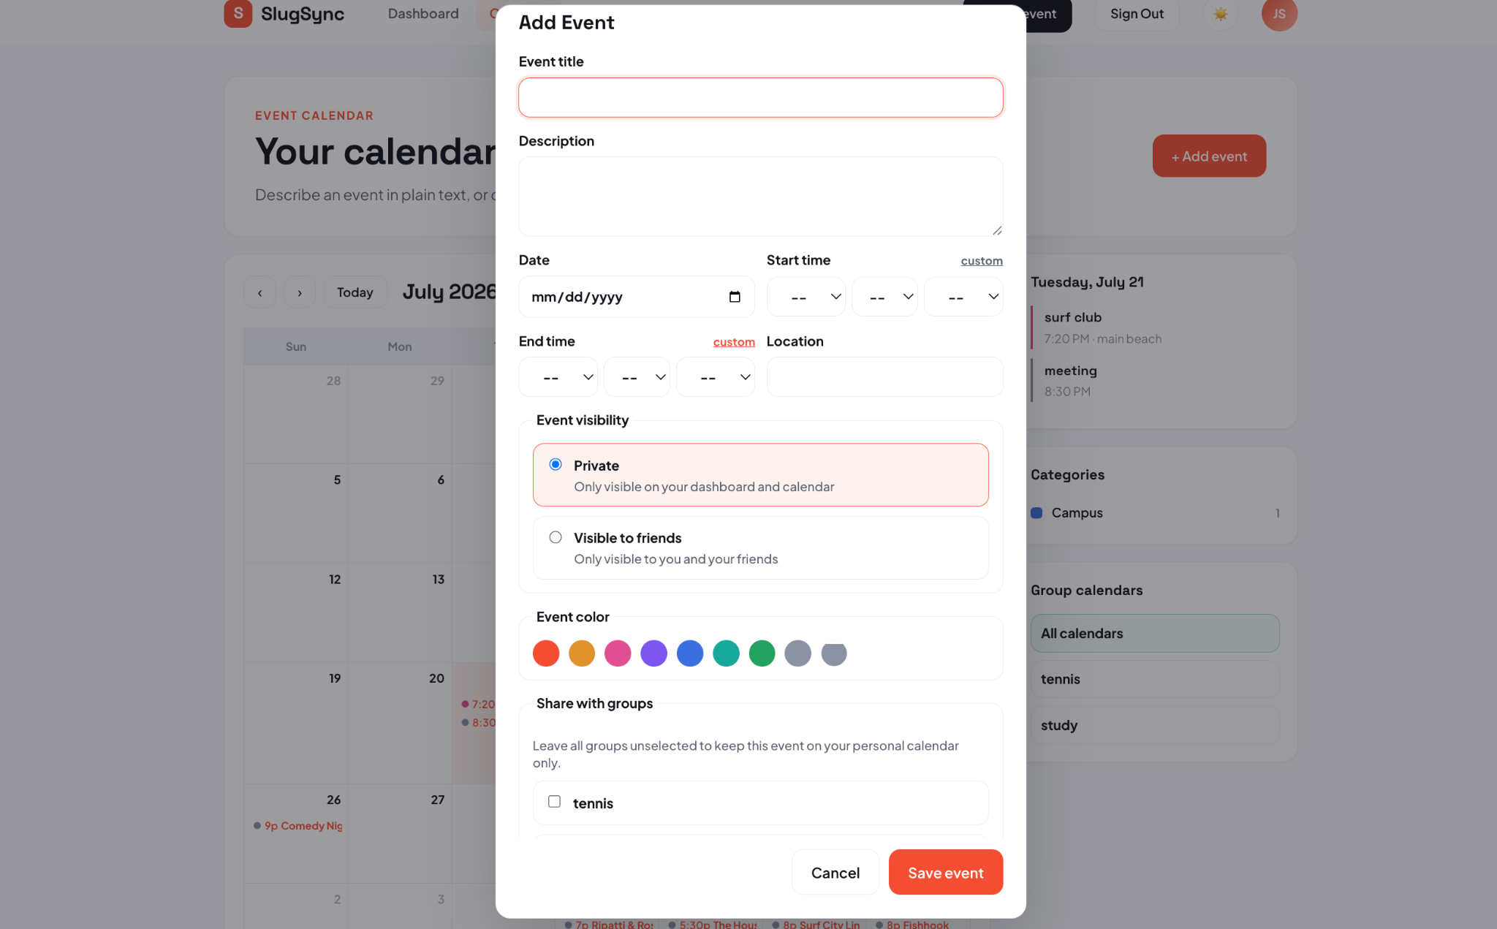

Slide 12
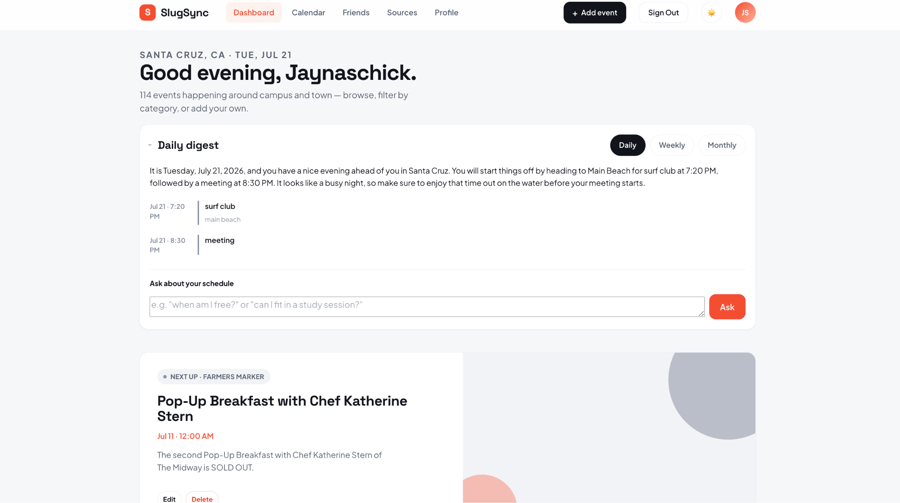

Slide 13
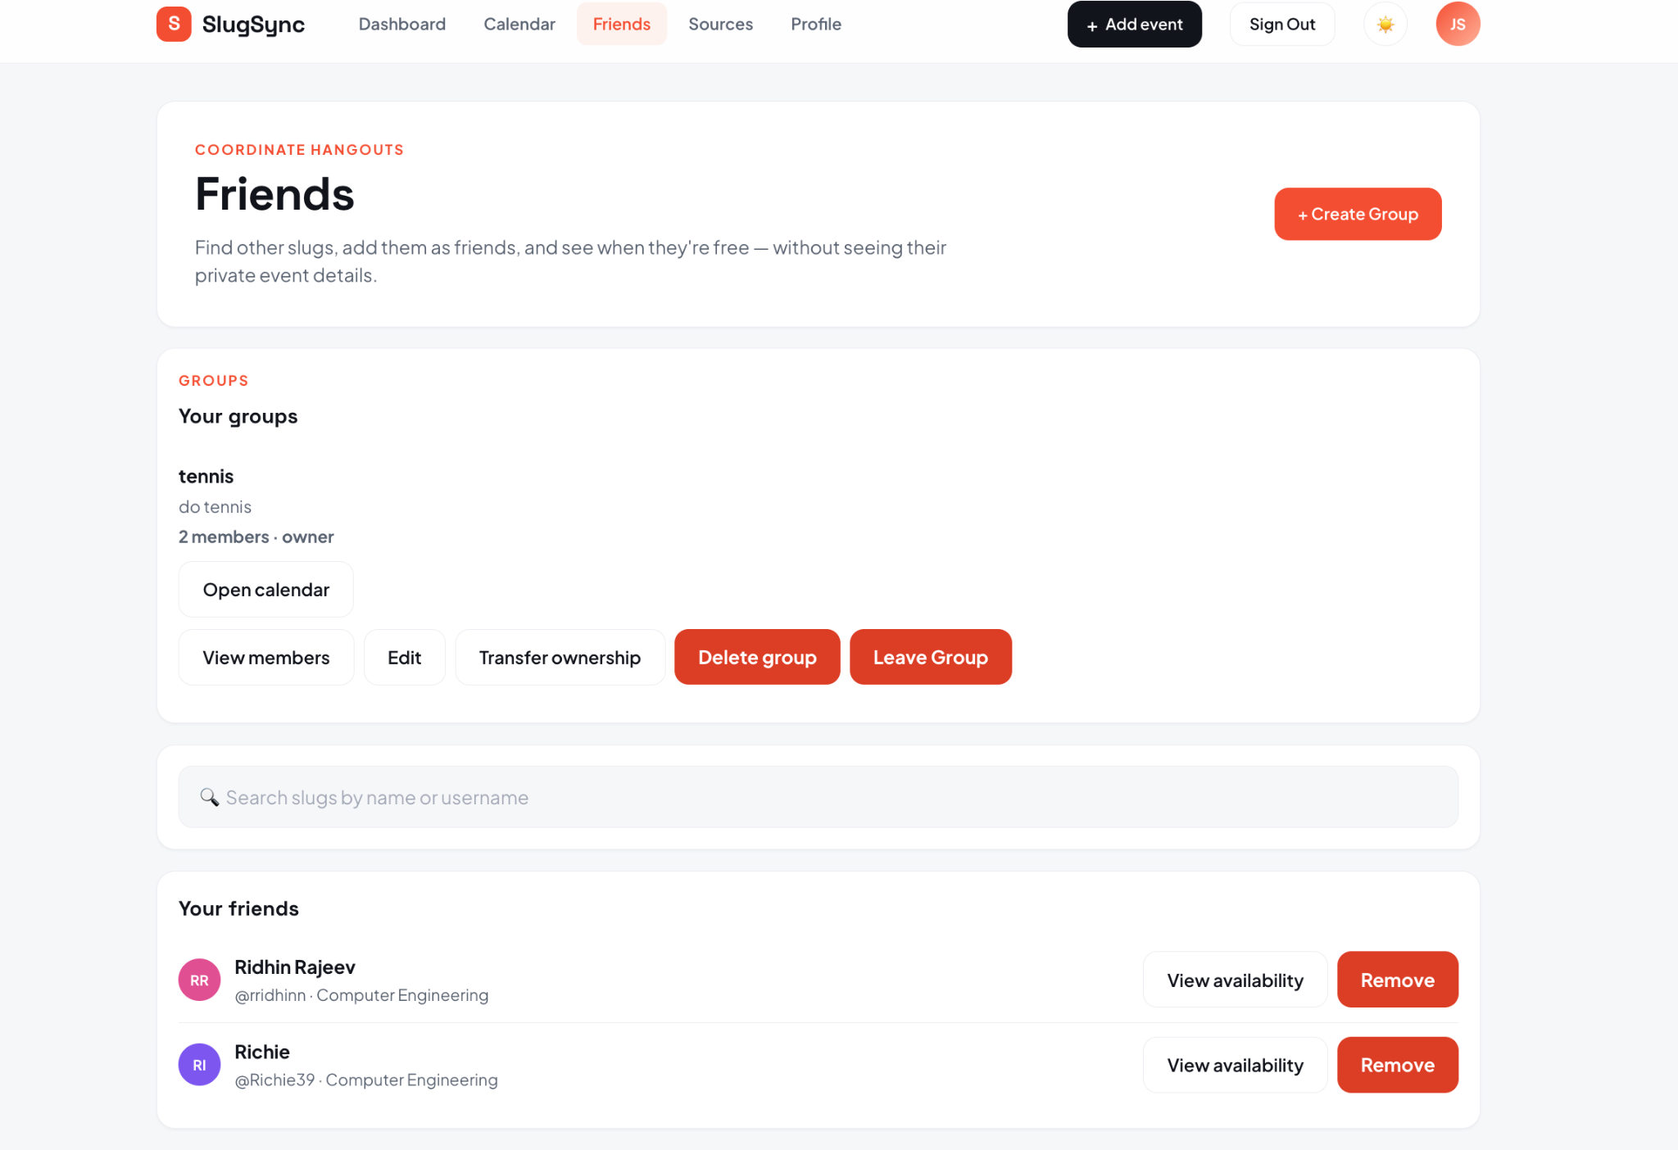

Slide 14
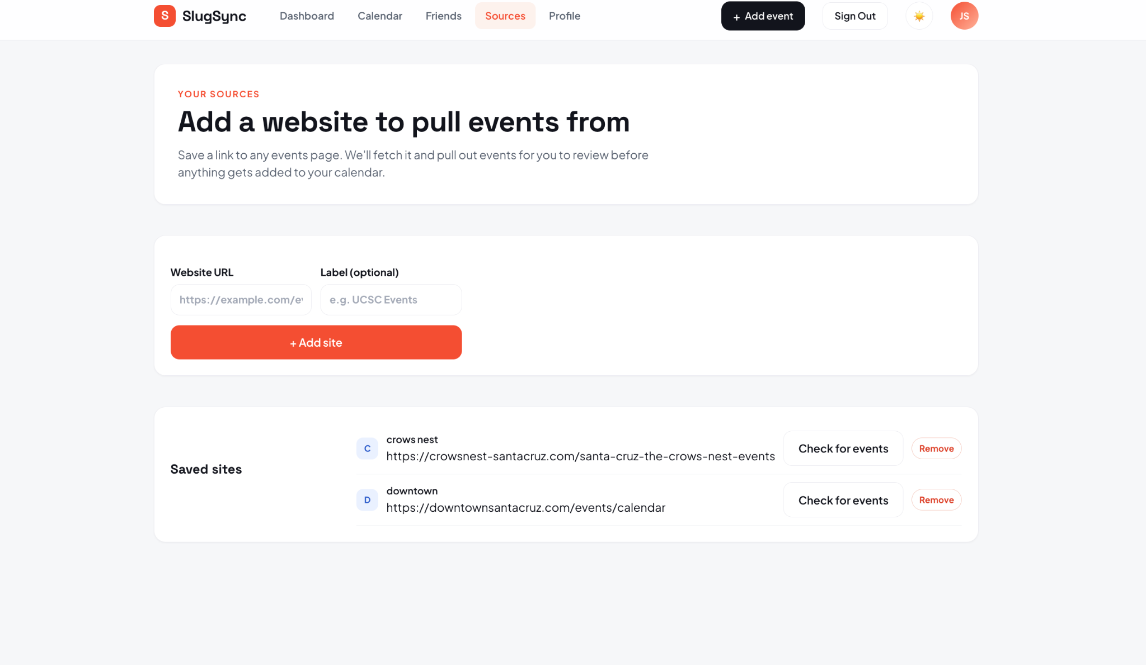

Slide 15
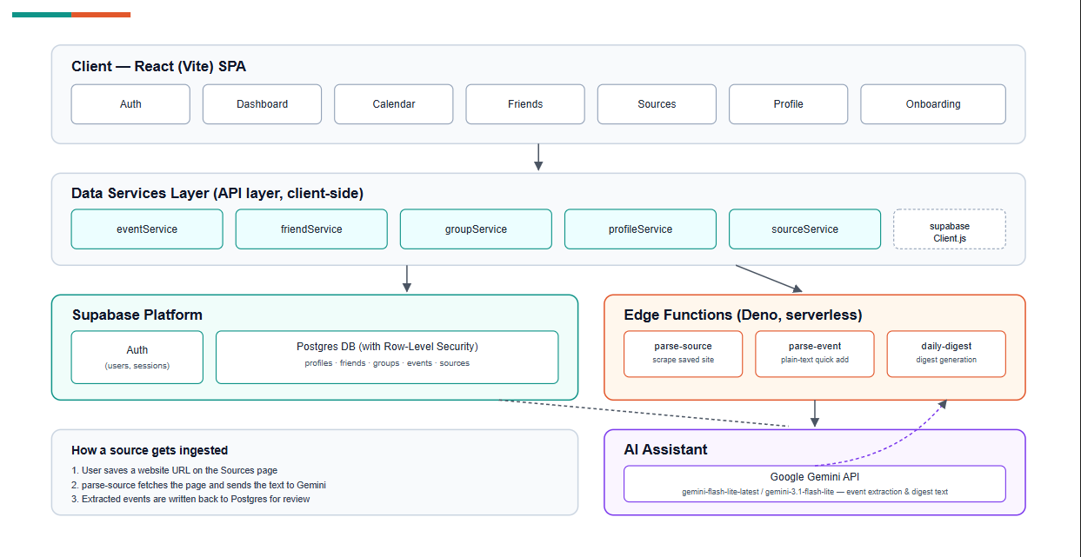
System overview/diagram

Slide 16
Technologies you used and what you used them for
Frontend:
React + Vite were used for the authentication, dashboard,calendar,friends,sources,profile, and onboarding pages
Full Calendar is used for the calendar ui and all its basic functionality such as the day/month/week toggle
Data Services: Client-side Javascript services connect the frontend to Supabase and the serverless functions
Backend: Supabase handles, authentication, the PostgreSQL database, storage, and Row Level Security
Serverless Processing: Supabase Edge function use Typescript and Deno to parse websites, create events, and generate daily digests
AI integration: The google Gemini API extracts event details from website content, helps generate digest summaries, and auto fills in calendar event information from sentences given to it

Slide 17
Project management techniques you used
-Scrum Framework for iterative development
-Sprint Planning to define goals and assign our user stories
- Scrum Meetings (1-3x per week) to discuss progress, blockers, and possible next steps
- Scrum board to track tasks through To Do-> in Progress -> Done (GIT)
-BurnUp Charts to monitor sprint progress and completed work
-GitHub for version control, pull requests, Scrum Board , and code reviews
- Task Prioritization using user stories and the Product backlog
-Sprint Reviews and Retrospectives to demonstrate completed features and improve team processes for possible next sprint
Notes:
Emiliano

Slide 18
Things you
Enjoyed
Creating an app
Learning scrum framework and implementing the majority of it
Learning more about agents and how to utilize them to code
Using claude design
Didn’t Enjoy
Uncertainty of working in a group
Tedious making of acceptance criteria even though it was useful

Slide 19
Lessons learned
– what worked/what you will keep doing
– what didn’t work/what you will stop doing
– things you wished you had done (that you would start doing in the future)
What worked / what we will keep doing
Using pull requests and reviewing changes before merging helped us combine our work more safely and reduced major merge conflicts.
Dividing larger features into separate tasks made it easier for each person to focus on their own work.
What didn’t work / what we will stop doing
Waiting until late in the sprint to clarify tasks created confusion and unnecessary rework.
Poor communication at certain points made it harder to coordinate changes and keep everyone on the same page.
What we wished we had done / what we will start doing
Define clear acceptance criteria for every user story at the beginning of each sprint.
Test features earlier and more often instead of leaving most integration testing until the end.

Slide 20
Biggest challenges
Regarding the final project:
We ran out of time to implement every feature we originally planned.
Some features, such as Instagram and Discord event integration, were more complicated than expected.
We also had to prioritize core functionality over fixing every smaller bug.
Regarding your development process:
Coordinating work between four people and making sure everyone’s code worked together.
Dealing with merge conflicts when multiple people edited the same files.
Keeping communication consistent and making sure tasks were completed on time.
Balancing new features, testing, documentation, and presentation preparation near the end of the project.

